Slide 1

Module 1: DTA Online Dementia Education
This presentation is a blueprint to help you achieve better Dementia health and wellbeing outcomes
Presented by
Ernest Buckley
Diversional Therapist
Image by: http://www.neura.edu.au/health/frontotemporal-dementia

Slide 2
Laying down the foundations
Laying down the foundations for successful Diversional Therapy activities for people with dementia.
To get started you should keep a holistic approach in mind and establish some principles when dealing with neurological disorders. That is, you’re not always just dealing with a client who has a form of dementia you could also be dealing with their family, carers, and other staff and challenging environments, etc.
Next, look at what resources you have, what is expected of you and if you are supported. If you don’t establish some basic principles of what you have and are expected to do early, you could find yourself coming unstuck very quickly or becoming overwhelmed. Remember look after yourself first then start to tackle laying down the foundations for successful and effective activities.

Slide 3
Step 1
Know your clients and abilities, just don’t run in and start Bingo when no one wants it. Develop an activity profile, an assessment, care plan and programme to complement the results.
Then work out what sort of budget, resources and time you have to do the job. Don’t be overwhelmed if you can’t do everything and prioritise what is needed most then evaluate at a given point. This will help keep you on track.

Slide 4
Step 2
Look at the age and stage of your client with dementia.
Why? Because it helps you to work out what you can offer or facilitate for them with the best results. The younger group could be wanting to participate in a different group of activities than the older group and at a different pace.
What are the three main groups and how do they differ?
Group one are the younger 50-64 year old individuals.
Group two are the 65-84 year old individuals.
Group three are the older 85 and above range.

Slide 5
Step 2
Group 1: The younger group (50 -64), have the biggest impact, the younger you are the more severe the dementia is likely be, the dementia type is easier to diagnose, the younger group spends more days needing services and people with alcohol related dementia have increased re-admissions.
Group 2: The middle group (65-84) on average starts to have a decrease in all the items listed for the younger group.
Group 3: The older people with dementia the (85 and above group) are harder to diagnose, the rate of deterioration slows down to a low pace and can have less impact.
Remember when working with these groups keep in mind that what the younger individual could do last week may be difficult this week and our older group will more than likely maintain their abilities for a much longer period.
The stage of dementia means you could be introduced to a client who is younger but he or she may be at a more advanced stage of dementia. They may be limited in their abilities and may also demonstrate behaviours of concern.

Slide 6
Step 3
What activities can we try for individuals who sit within these groups?
What are your thoughts?
Here are some suggestions……..

Slide 7
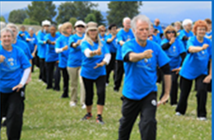
Group 1 Activities
Encourage to start early attendance at Dementia or other Day Care Services.
Choose the appropriate level of activity and age group if you can.
Keep to a routine
Challenge the individual cognitively
Physically challenge the individual.
Encourage to participate in community events and socialise.
Strength building activities: Tai Chi, Yoga and Massage
Massage and Touch is very much overlooked. Touch is a very important part of attempting to keep a healthy mind / body balance. Touch can come in a wide variety of forms and in different services.
Image from: http://www.dawanews.com/chinabiz_view.asp?id=24540

Slide 8
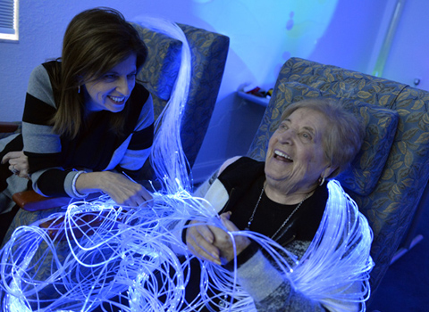
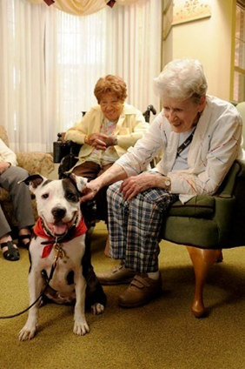
Introduce Sensory Activities
Sensory Activities can come in a wide variety of forms, services and activities.
One form is to facilitate different Snoezelen activities. This covers a wide variety of therapeutic activities.
Environmental activities: water (rain or sea), wind,
the moon and sun
Olfactory activities: cooking, BBQs and herb recognition
Animal therapy: Dog therapy, animal visits and reptile visits
Visual : Fish tanks, living picture fish tanks and mobiles
Reminiscence: Individual boxes, scrapbooks, Your life books and photos
Auditory: Appropriate music, calm or stimulating.
Pet therapy image: http://shelter-tails.blogspot.com.au/2011/02/animal-farm-foundation.html
Snoezelen image: http://health.heraldtribune.com/2013/11/18/therapy-for-the-senses/

Slide 9
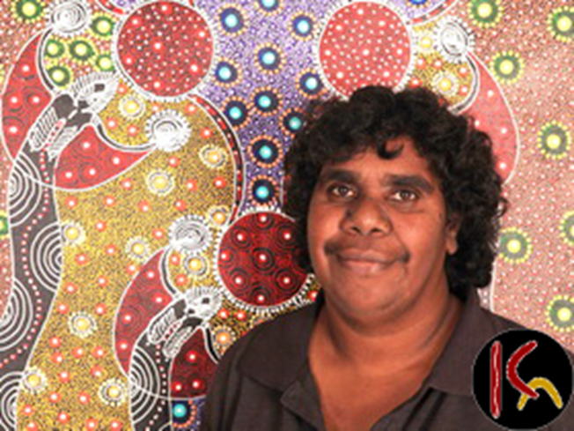
Group 2 Activities
You can continue most of your activities from Group 1 dementia into this stage but as you experience the individual deteriorating and not able to participate in an activity anymore, replace it with sensory activities.
Depending on the age and the rate of decline it would be expected that there are signs of deterioration through to group 3 where it should have slowed down significantly.
Image from: http://www.aboriginalartstore.com.au/artists/colleen-wallace-nungari/

Slide 10
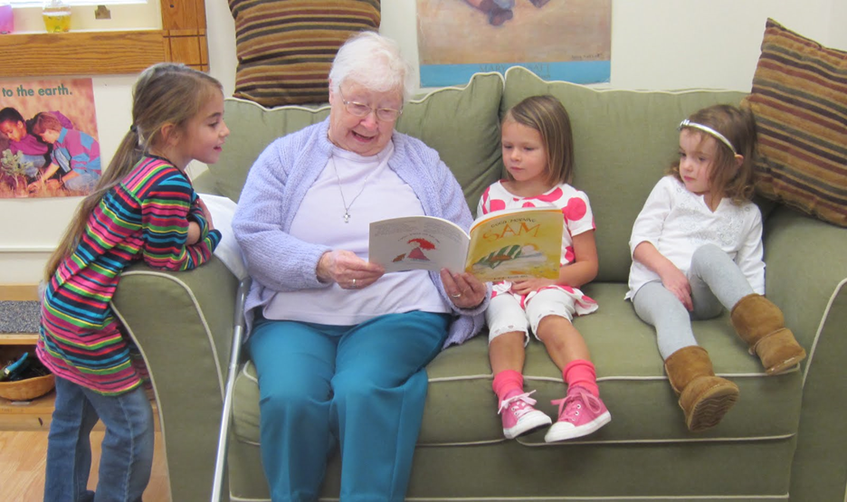
Group 2 Activities
Pre School Children Activities: arrange a regular morning tea with a small group of preschoolers.
In house or Day Care centre activities, modified bowls, indoor golf, crafts , modified exercise and movement activities. e.g .Pom Pom swing activities, catch and throw activities, table games and quizzes.
Daily Living Activities
Current affairs
Outings
Craft and Table games
Reminiscence Activities
Musical Activities
Laughter
Montessori-Based activities
You add to the list what you find works well with the individual.
Image by: http://westhartfordnews.blogspot.com.au/2013/02/literacy-focus-for-community-volunteers.html

Slide 11
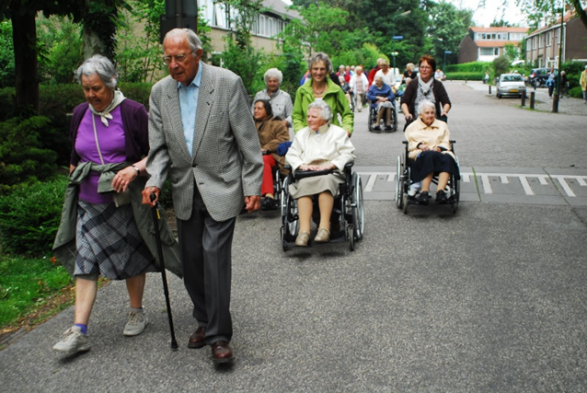
Group 3 Activities
When an individual person gets to this stage you can find that most of their chosen activity capabilities have gone. What you should be now engaging in is:
A full range of low impact sensory type activity
Assist with a small walking programme if you can
Modify the noise to almost minimal
Keep a friendly home-like environment
Move closer to nature
Maximise sun and nature related activities
Keep a calm environment
Doing less at this stage may be beneficial
Image by: http://lavinia-marianne.blogspot.com.au/2010/06/elderly-walk.html

Slide 12
Step 4
Look at the YouTube videos Part 1 & 2 and you should be able to by now be able to formulate a successful dementia activity programme.
These clips cater for a wide range of clients.
The Videos are set in an Aged Care facility in Ireland and are very good examples of facilitating holistic activity programming.
http://www.youtube.com/watch?v=FHtKpF2csj4
http://www.youtube.com/watch?v=QogOR8jawUw

Slide 13
Special thanks to…
Eira Steane, Diversional Therapist, Multi-site Lifestyle and Volunteer Coordinator,
Assisting editor, BaptistCare, Carlingford, NSW
Joe Merlino, Power Point Presentation Assistant. University Of NSW
Rosalind Brenner, MSC D, Assisting editor, Prince of Wales Hospital
Niranjan Prasai, Assisting editor, Prince of Wales Hospital
This module has been formulated over a period of time by attending Sydney’s Dementia Collaborative Research Centres monthly Lab meetings; Working in my role at The Prince of Wales Hospital’s Dementia Day Care Respite Centre at Randwick, Sydney; Participating in ongoing work related education; Participating in DTA and other Educational Institutional ongoing Forums, Conventions and Workshops; The Kings Park Community Hospital Dementia Unit, Bournemouth, England; The Bernardus Centre, Amsterdam, The Netherlands

Slide 14
In Conclusion…
This brief Diversional Therapy Dementia Education Session will get you started to think about, and research more into, what you can try when facilitating programs for people with dementia. Don’t be afraid to give something a go, but keep it in mind it may be best to go slowly at the beginning and not overstimulate the situation. Slow steps are best, and take people with you as you develop.
Ernest Buckley DT
Merci beaucoup!

